Slide 1
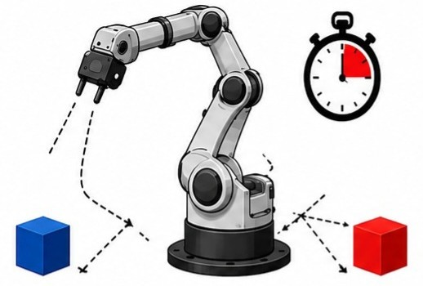
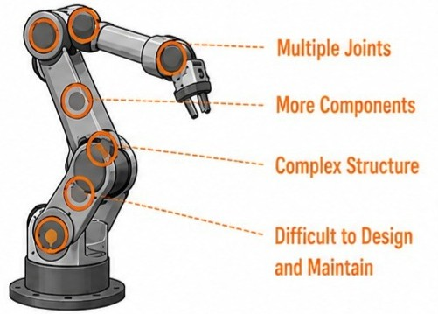
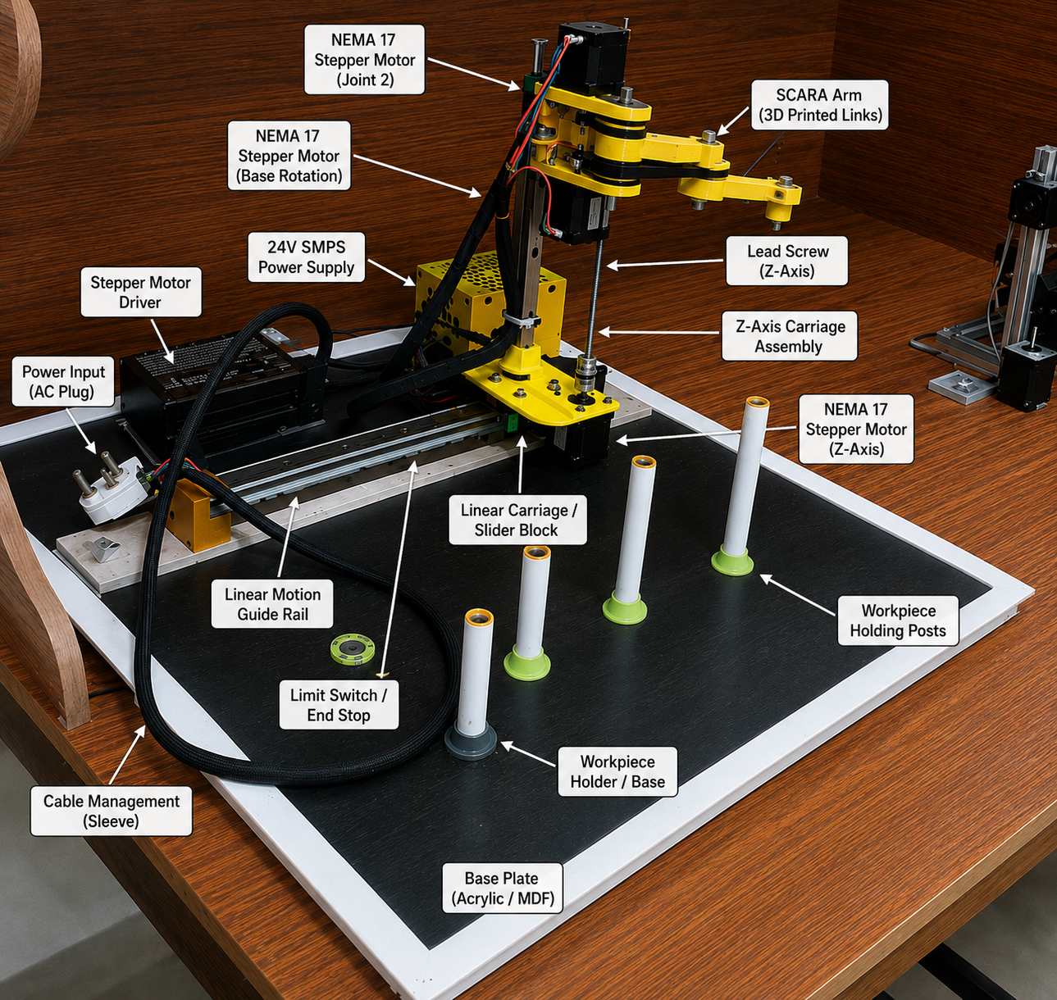
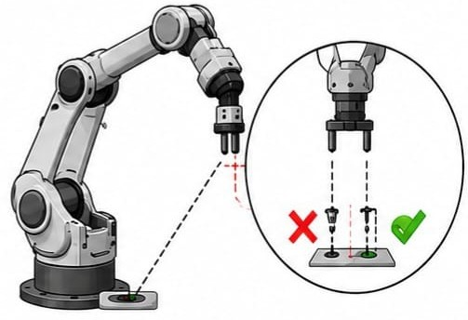
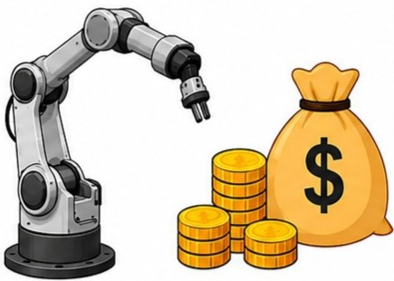
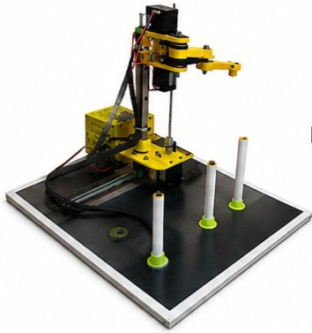
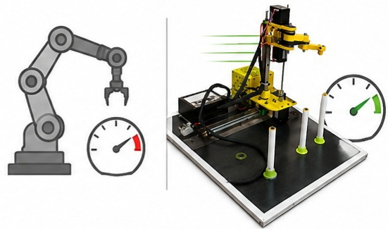
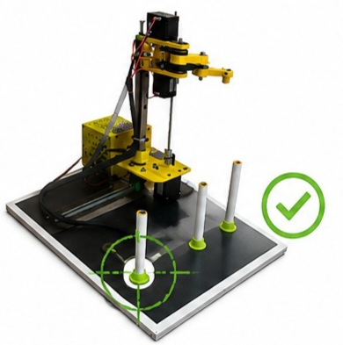
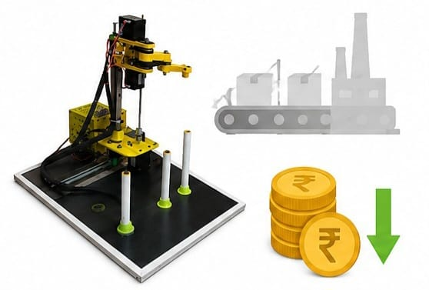
Pick and Place SCARA Robot
Problems Identification (もんだいていき)
Prototype image(しさくき の がぞう)
Slower Operating Speed
Complex Mechanical Design
Lower Positioning Accuracy
High Cost
Objectives(もくてき)
High Operating Speed
Simplified Mechanical Design
My Role in the Project
(プロジェクト における わたし の やくわり)
->Arduino Programming
->Motor Driver Interfacing
->Electronic Circuit Integration
Presented by:
K.Indhu
Aditya University
High Positioning Accuracy
Cost Effective

Slide 2
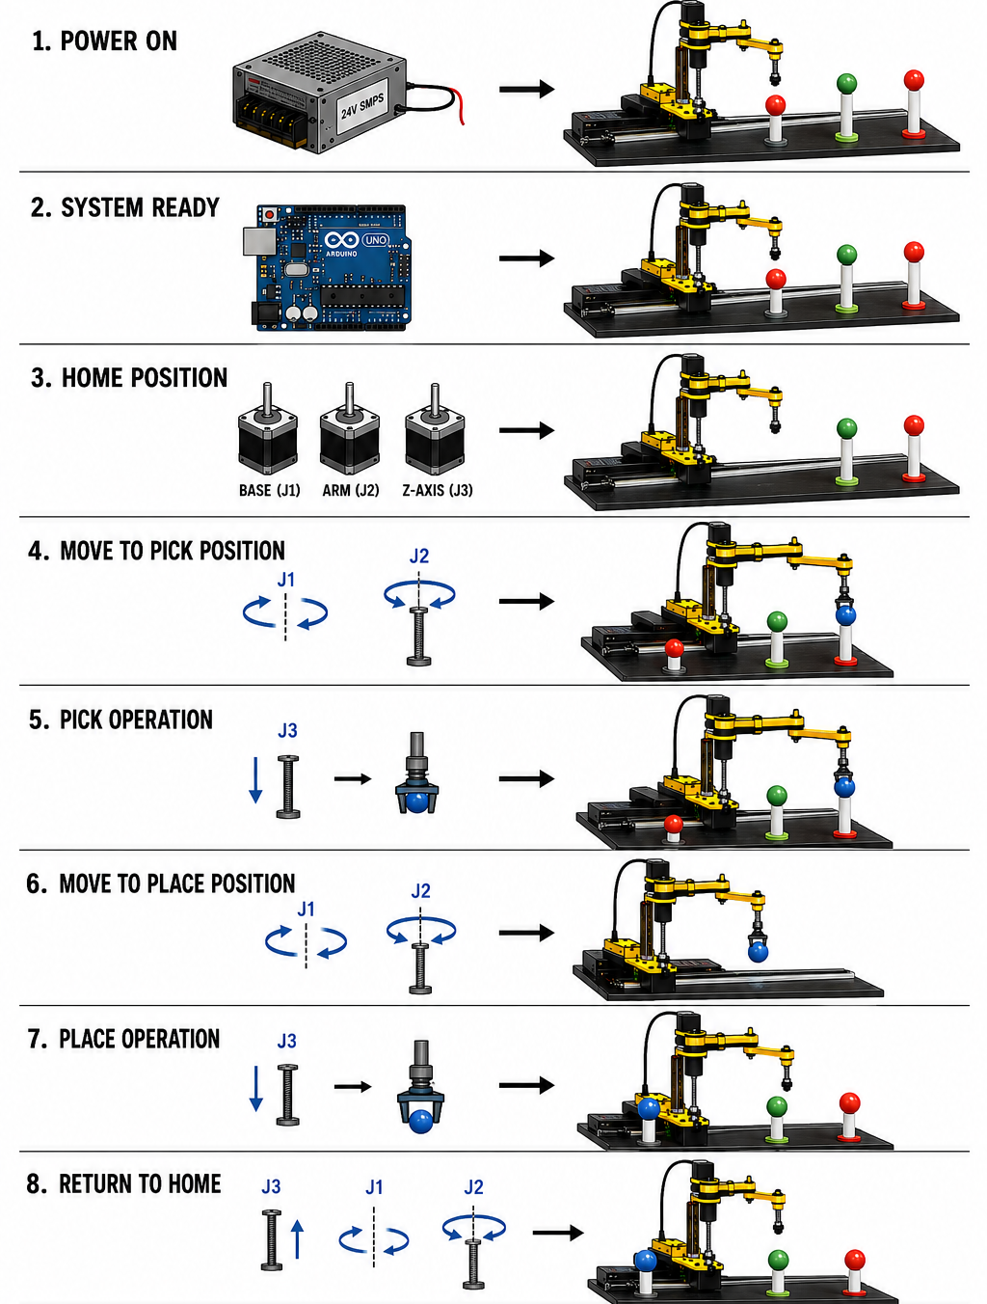
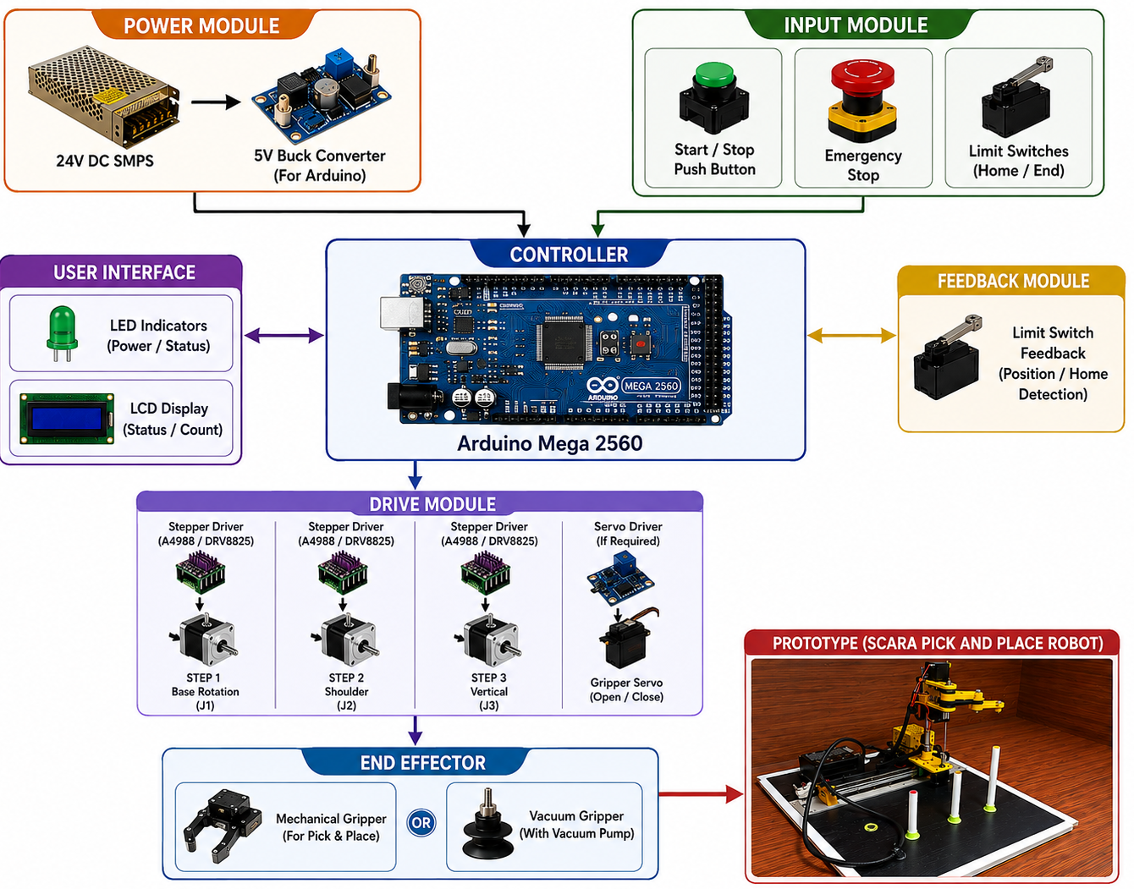
System Architecture: (システムアーキテクチャ)
Working Mechanism: (どうさげんり)

Slide 3
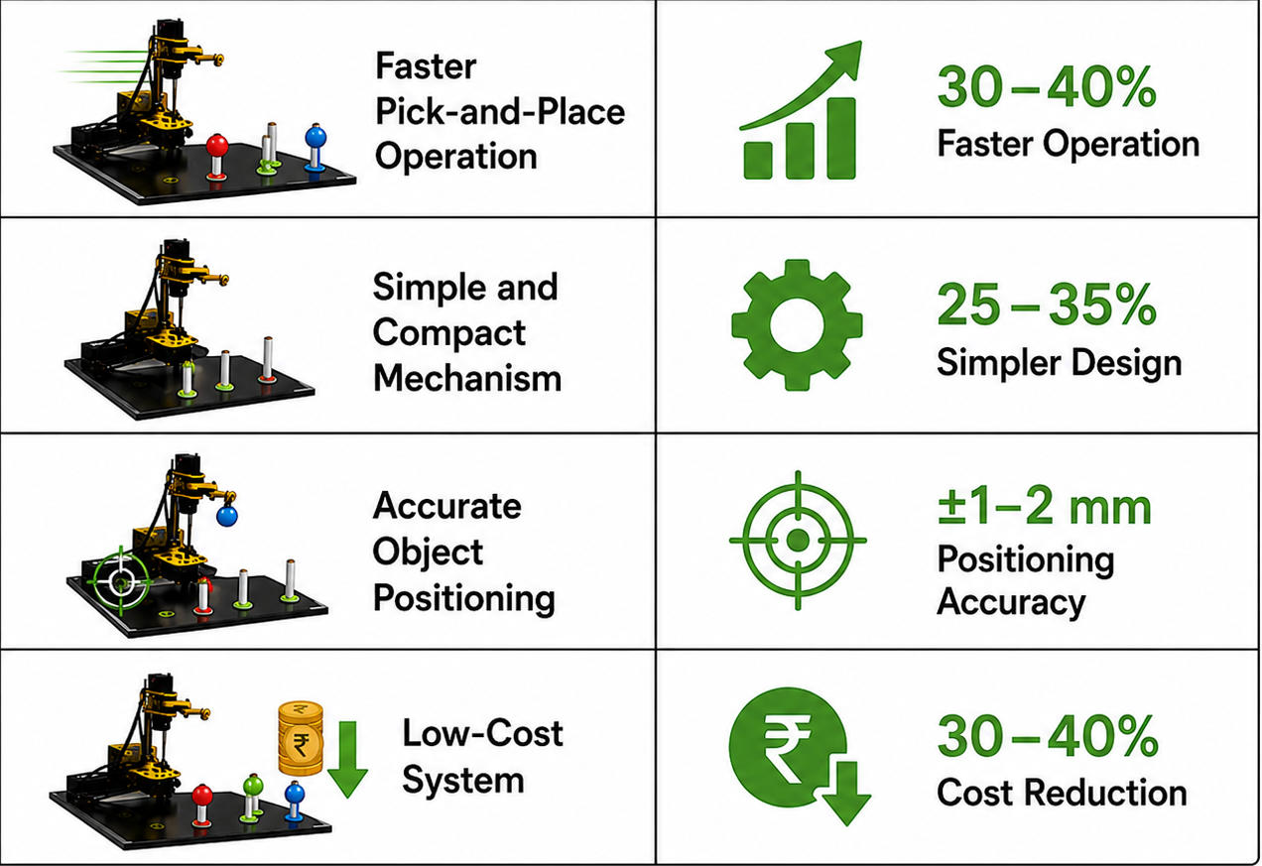
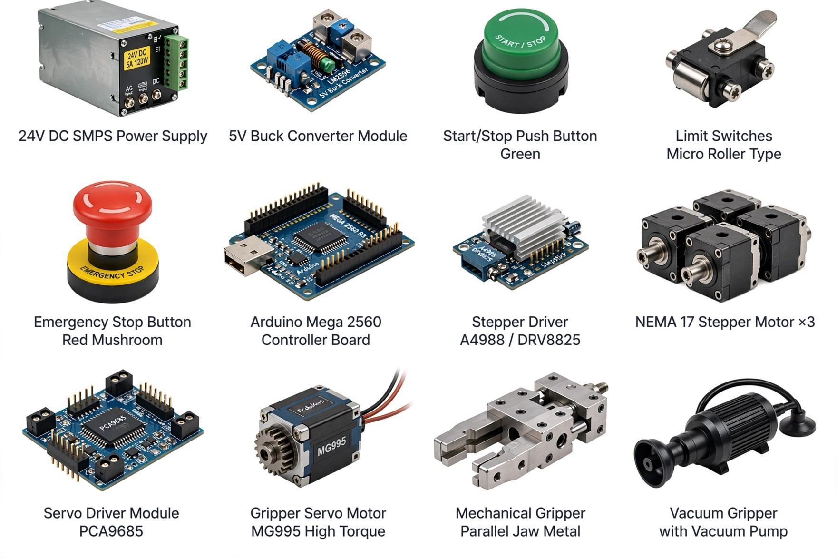

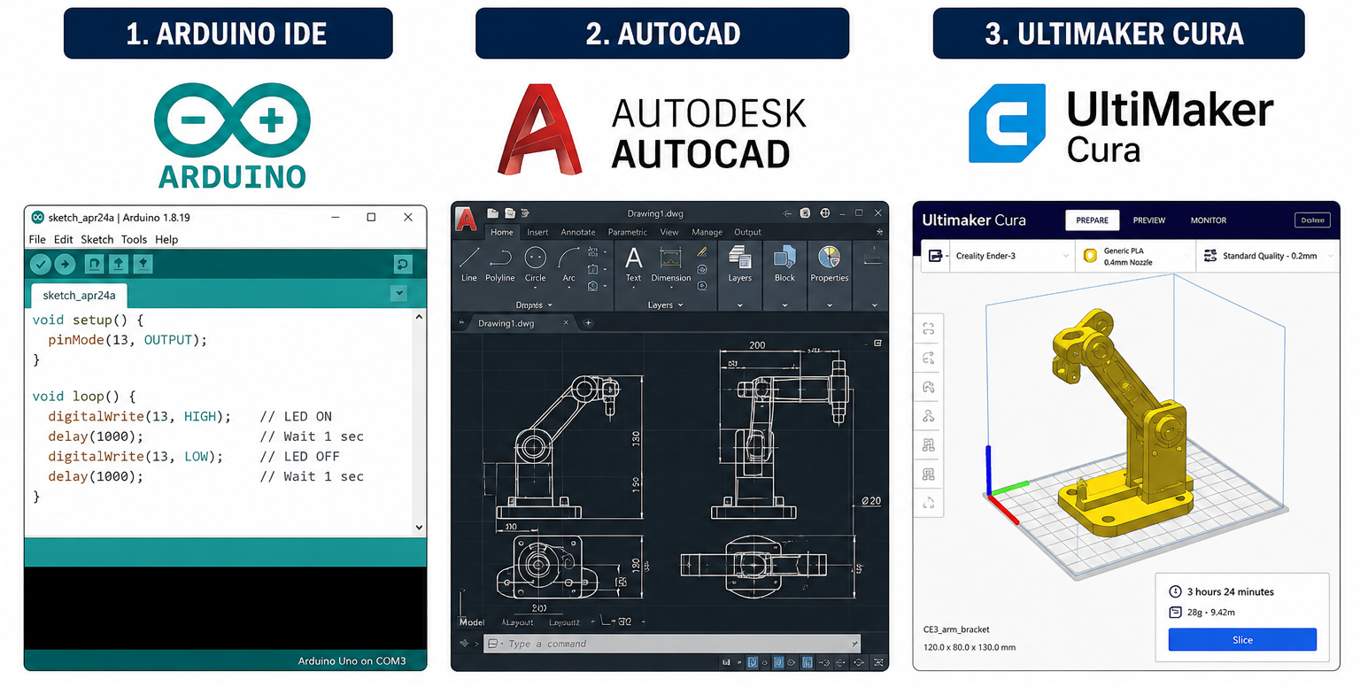
Technologies Used: (しようぎじゅつ )
Results(プロジェクトのけっか)
Hardware:
Future Scope（こんご の かいぜん）
Machine Vision Integration
PLC-Based Industrial Automation
Automated Conveyor Integration
Software (しようにんのそふと)

Slide 4
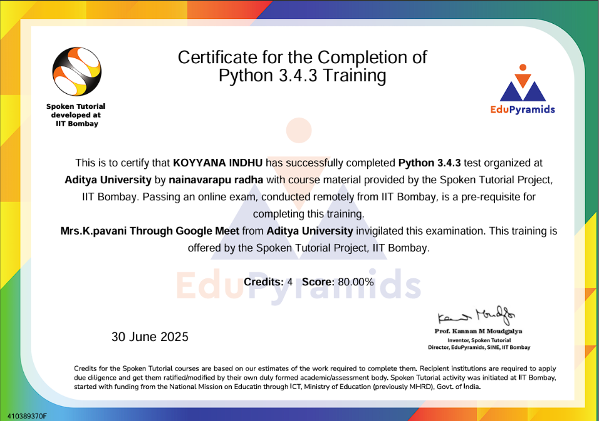


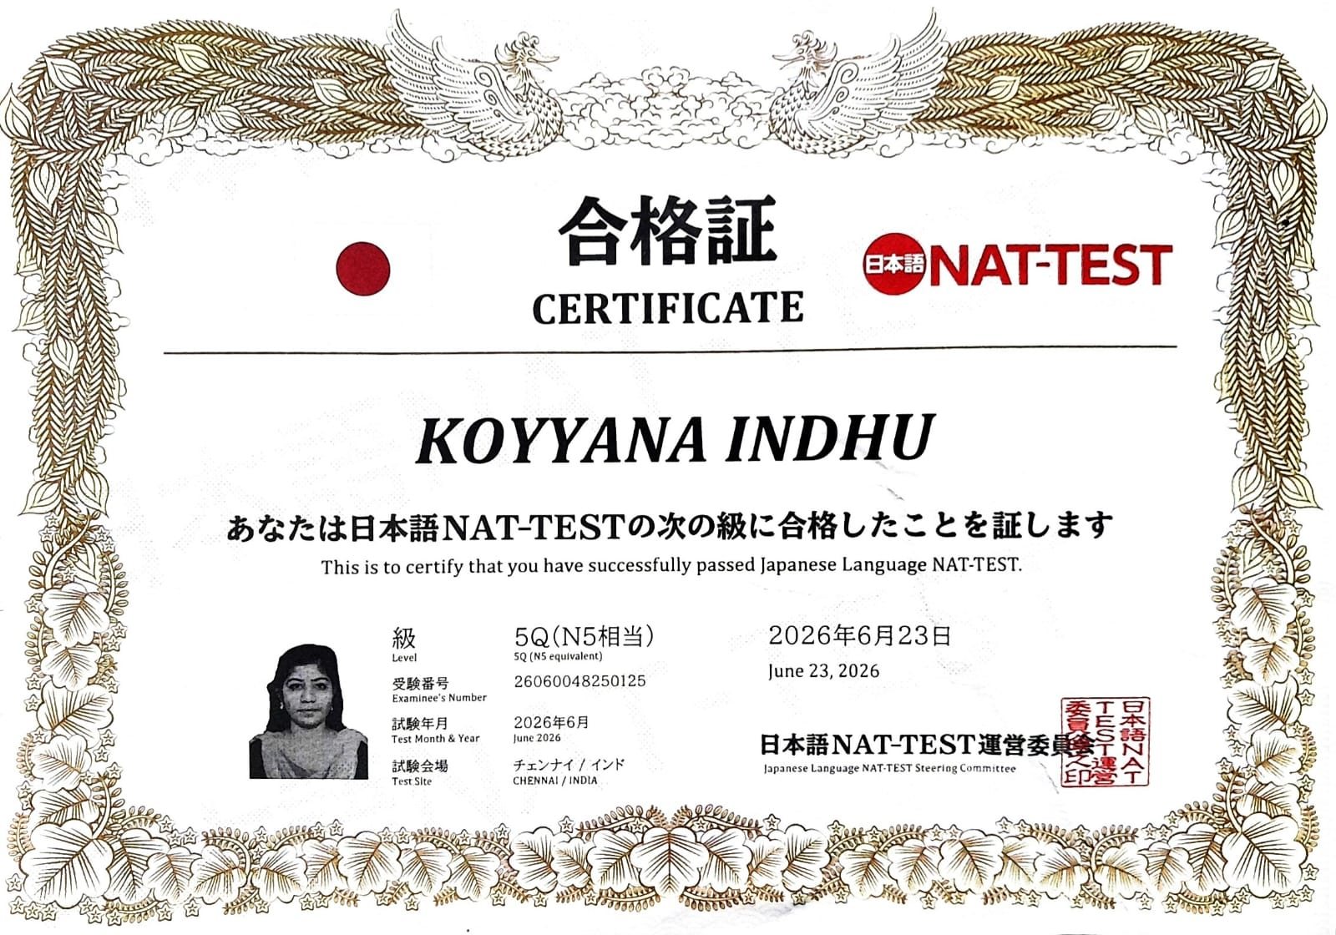

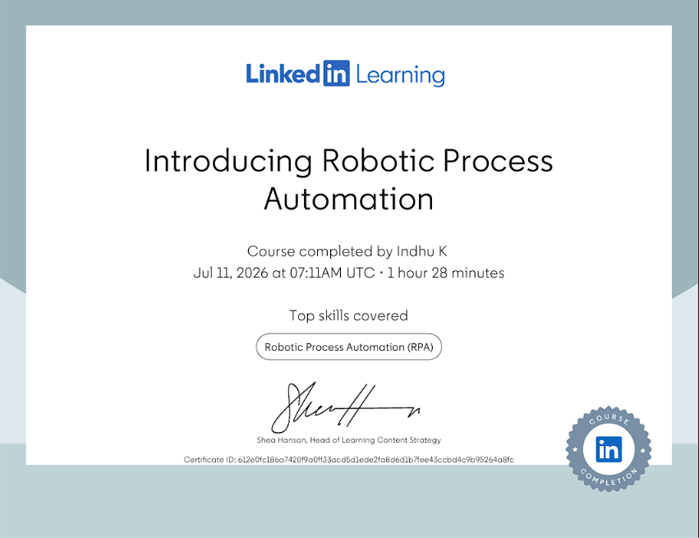
Certifications & Achievements

